Slide 1
Customer Segmentation in Insurance Portfolio
Leveraging Data Analytics for Strategic Insights
By Rounak Pyne

Slide 2
Introduction:
Objective: To present a detailed analysis of customer segmentation within an insurance portfolio to enhance marketing strategies, customer retention, load approval, wealth management and product development.
Scope: Overview of methodologies, data analysis, segmentation techniques, and actionable insights.

Slide 3
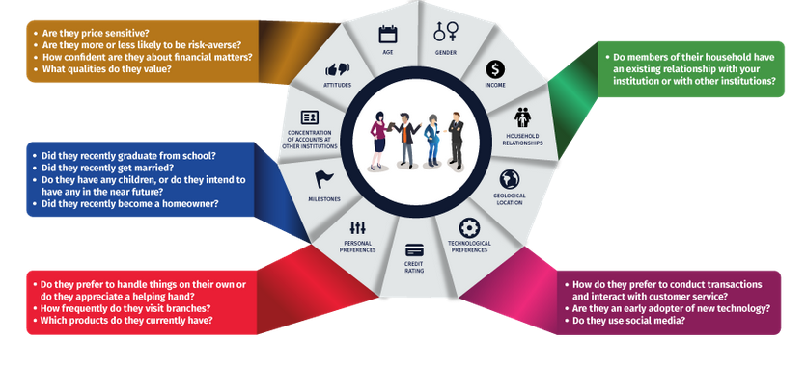
Objective :

Slide 4
Importance of Customer Segmentation:
Understanding Customer Needs: Tailoring products and services to different segments.
Enhancing Customer Experience: Personalized marketing and communication.
Optimizing Resources: Efficient allocation of marketing and service efforts.

Slide 5
Data Collection and Preparation :
Data Sources: Customer demographics, policy details, claim history, interaction logs. Link to data
Data Cleaning: Handling missing values, and ensuring data quality.
Feature Selection: Key variables influencing customer behavior.
BALANCE,BALANCE_FREQUENCY,PURCHASES,ONEOFF_PURCHASES,INSTALLMENTS_PURCHASES,CASH_ADVANCE,PURCHASES_FREQUENCY,ONEOFF_PURCHASES_FREQUENCY,PURCHASES_INSTALLMENTS_FREQUENCY,CASH_ADVANCE_FREQUENCY,CASH_ADVANCE_TRX,PURCHASES_TRX,CREDIT_LIMIT,PAYMENTS,MINIMUM_PAYMENTS,PRC_FULL_PAYMENT,TENURE

Slide 6
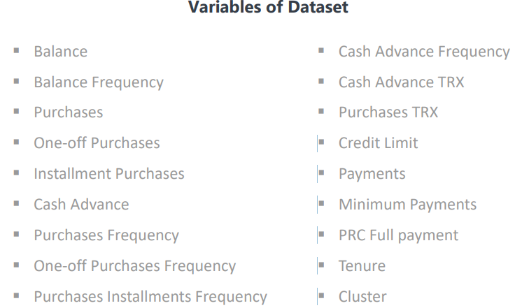
About Dataset:
The sample Dataset summarizes the usage behavior of about 9000 active credit card holders during the last 6 months. The file is at a customer level with 18 behavioral variables.

Slide 7
Segmentation Methodology :
Clustering Techniques: K-means, hierarchical clustering, DBSCAN.
Choosing the Right Model: Criteria for selecting the optimal clustering algorithm.
Dimensionality Reduction: PCA (Principal Component Analysis) to simplify data.

Slide 8
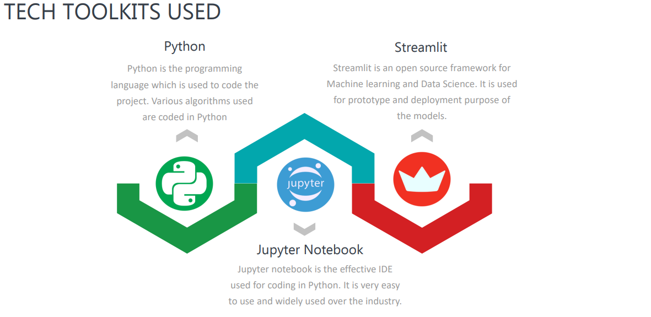
Tools Used:

Slide 9
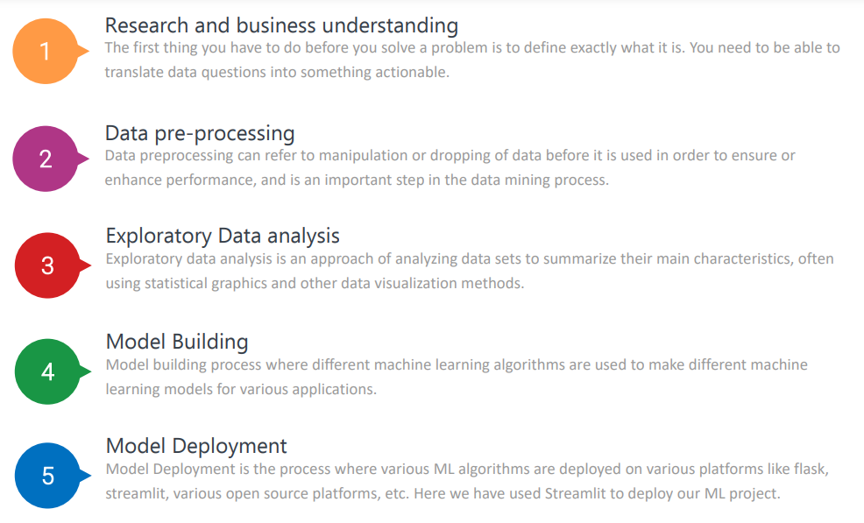
Project Process:

Slide 10
Data Analysis and Exploration :
Descriptive Statistics: Overview of data distribution and key metrics.
Visualization: Histograms, scatter plots to understand patterns..
Correlation Analysis: Identifying relationships between variables.

Slide 11
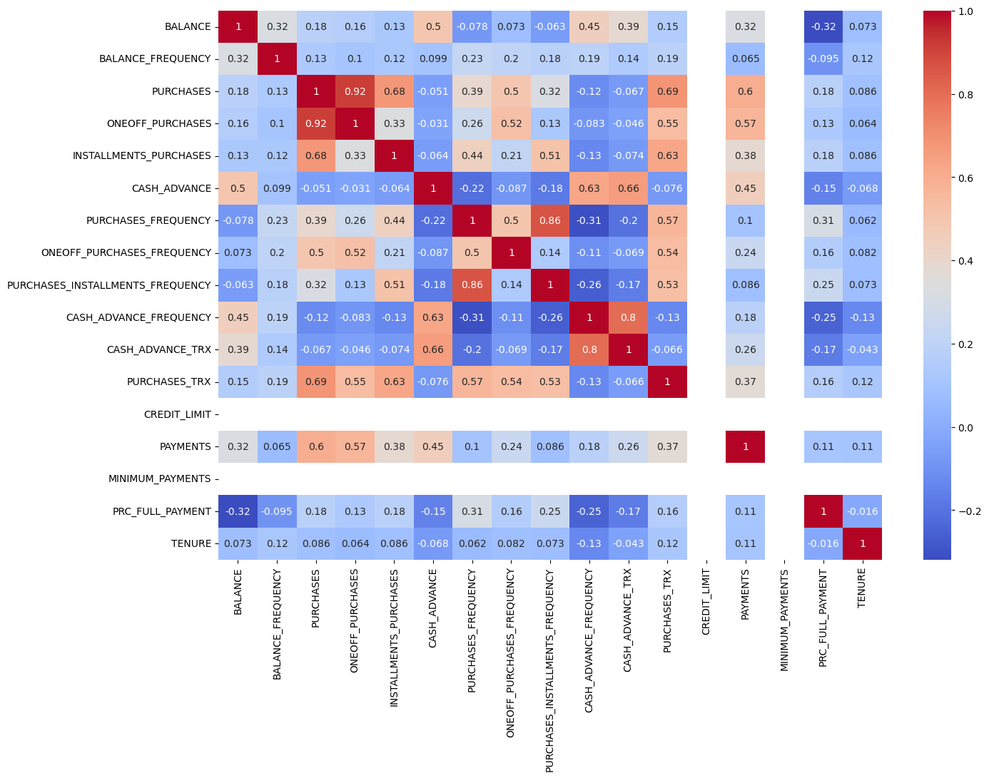
Co-relation matrix :

Slide 12
Implementing Segmentation :
Clustering Implementation: Step-by-step process using selected algorithm.
Number of Clusters: Determining optimal clusters using the Elbow method which in this case is 4.
Cluster Profiling: Detailed characteristics and profiles of each segment.

Slide 13
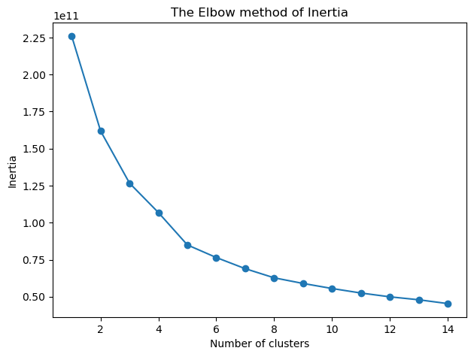
The Elbow method of Inertia:

Slide 14
Results and Insights :
Segment Profiles: Demographic, behavioral, and financial profiles of each cluster.
Key Findings: Significant differences and trends within segments.
Case Studies: Real-world examples of how segments respond to different strategies.

Slide 15
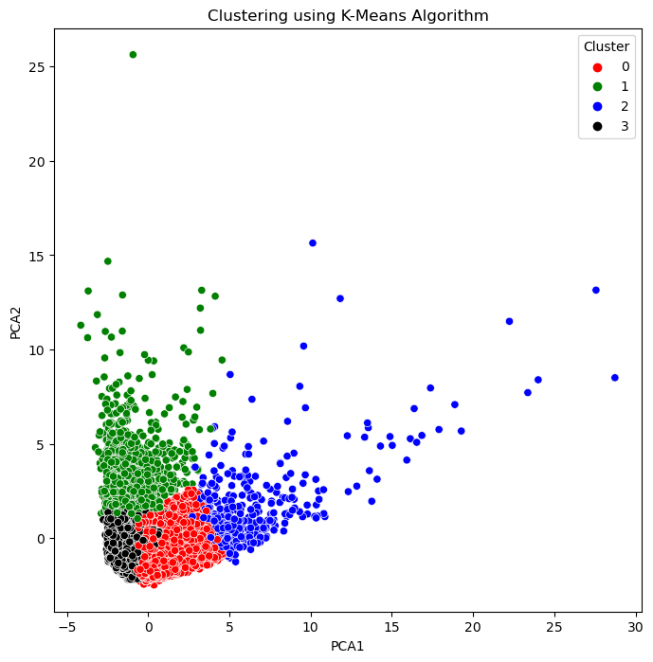
Clustering using K-Means Algorithm:

Slide 16
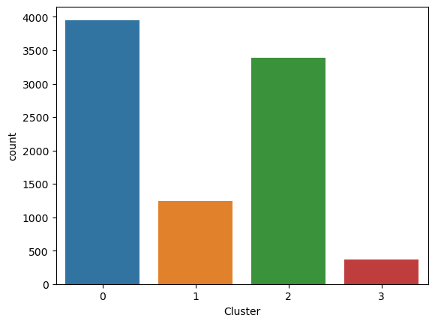
Cluster Distribution:

Slide 17
Business Implications :
Targeted Marketing: Customized campaigns for different segments.
Product Development: Tailoring insurance products to meet segment needs.
Customer Retention: Strategies to improve loyalty and reduce churn.

Slide 18
Challenges and Considerations :
Data Privacy: Ensuring compliance with regulations
Model Validation: Continuous monitoring and validation of segmentation model.
Scalability: Implementing the model across large datasets and evolving markets.

Slide 19
Conclusion and Recommendations :
Strategic Recommendations: Actionable steps for leveraging segmentation insights.
Next Steps: Future research and implementation plans.
Contact Information: rounakpyne.official@gmail.com for any query.

